Slide 1
Natural Language Processing
Large Language Models and Generative AI

Slide 2
Contents
Introduction to Large Language Models
LLM-based NLP tasks
Hugging Face 🤗

Slide 3
Contents
Introduction to Large Language Models
LLM-based NLP tasks
Hugging Face 🤗

Slide 4
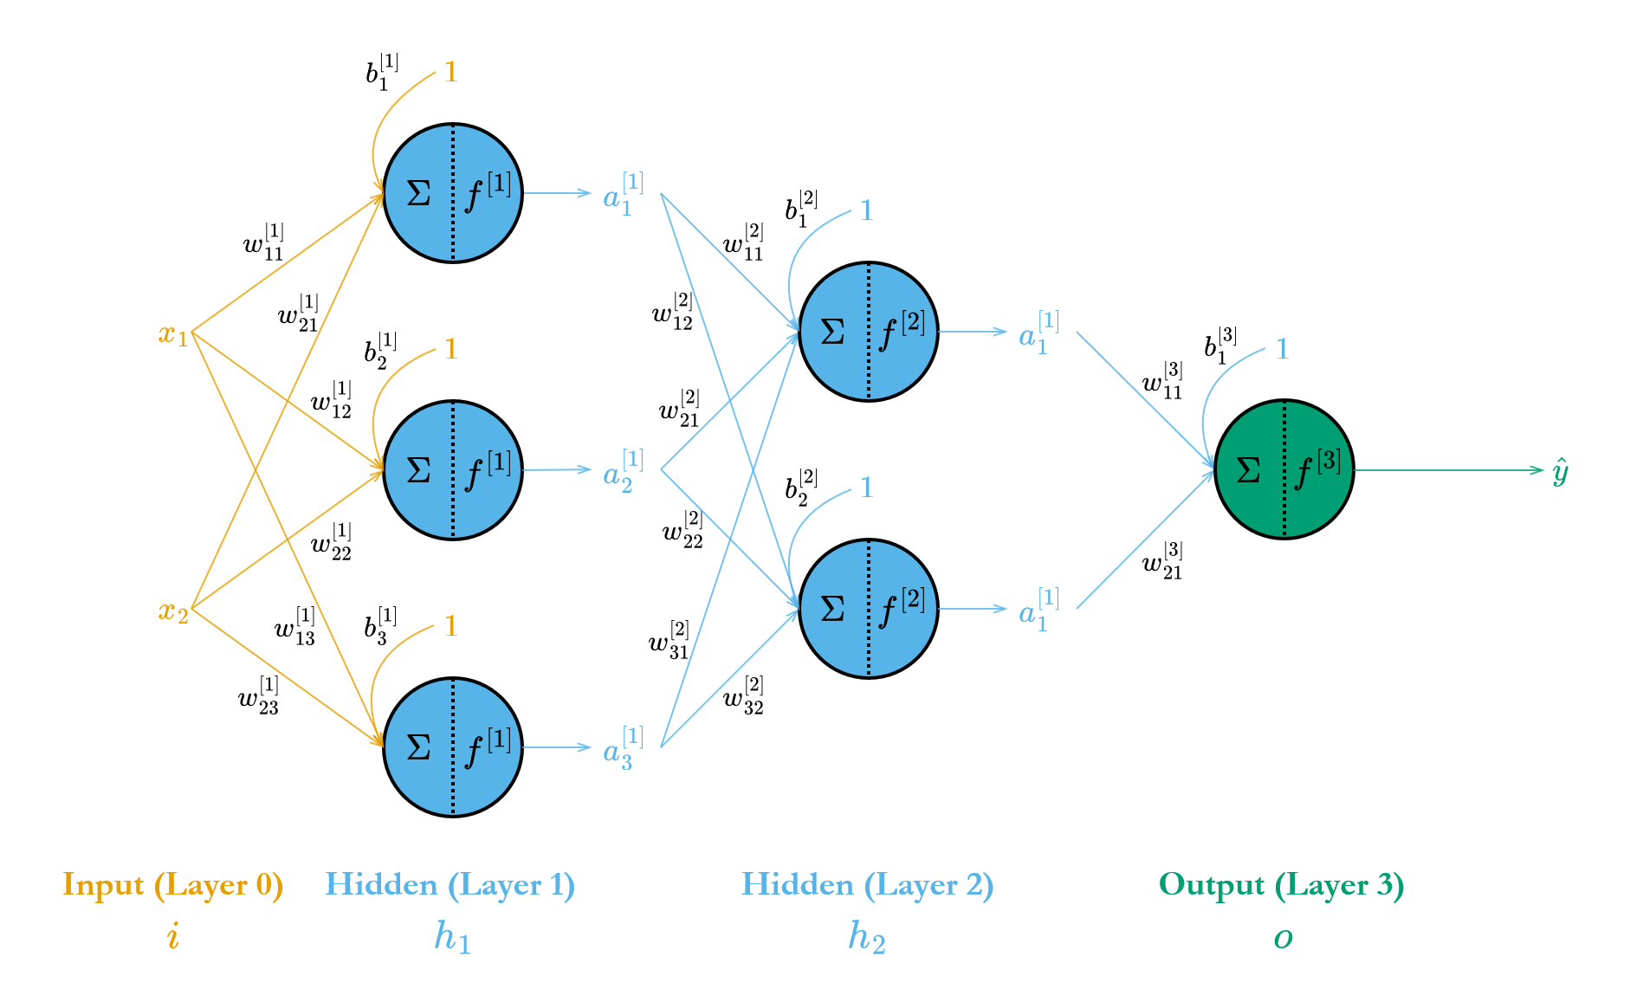
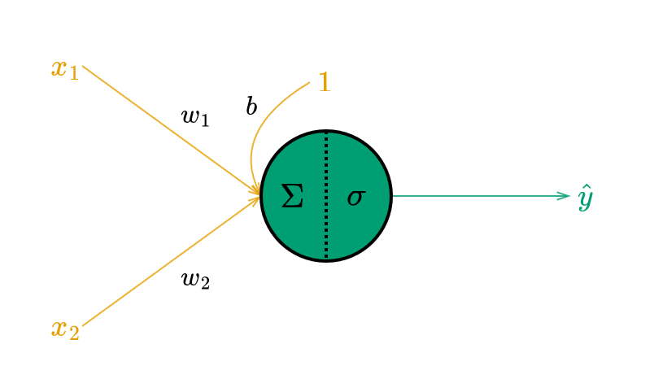
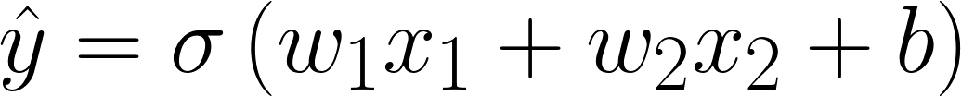
A very quick intro to Deep Learning
Deep learning is a subfield of machine learning that uses a class of models called artificial neural networks to perform complex tasks.
Logistic Regression with two features represented as a neuron
A simple feedforward network with two hidden layers

Slide 5
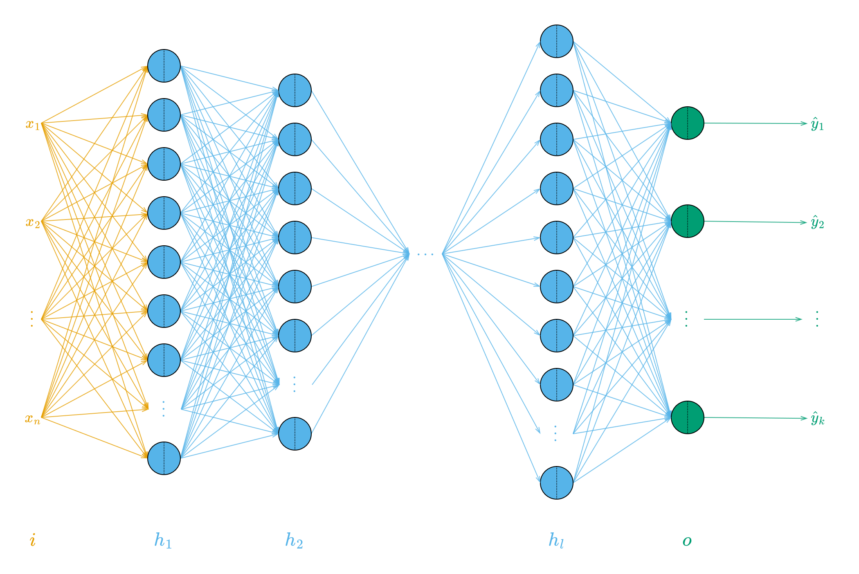
“Deep” neural networks
Deep neural networks can have hundreds (or even thousands) of hidden layers (with each layer containing a large number of neurons) that enable it to capture very complex relationships between inputs and outputs.

Slide 6
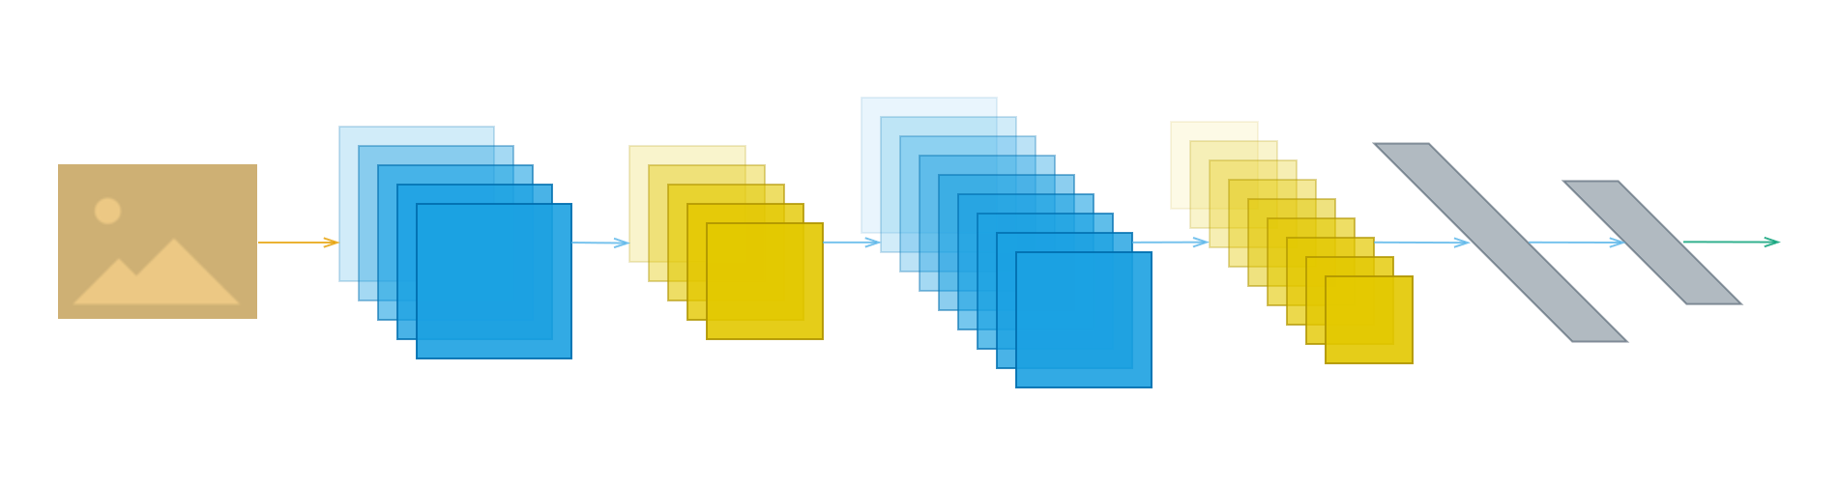
Convolutional neural networks for image processing
“Fully connected” networks do not scale well for high dimensional inputs such as images.
Instead, convolution (blue) and pooling (gold) layers are used to extract features.

Slide 7
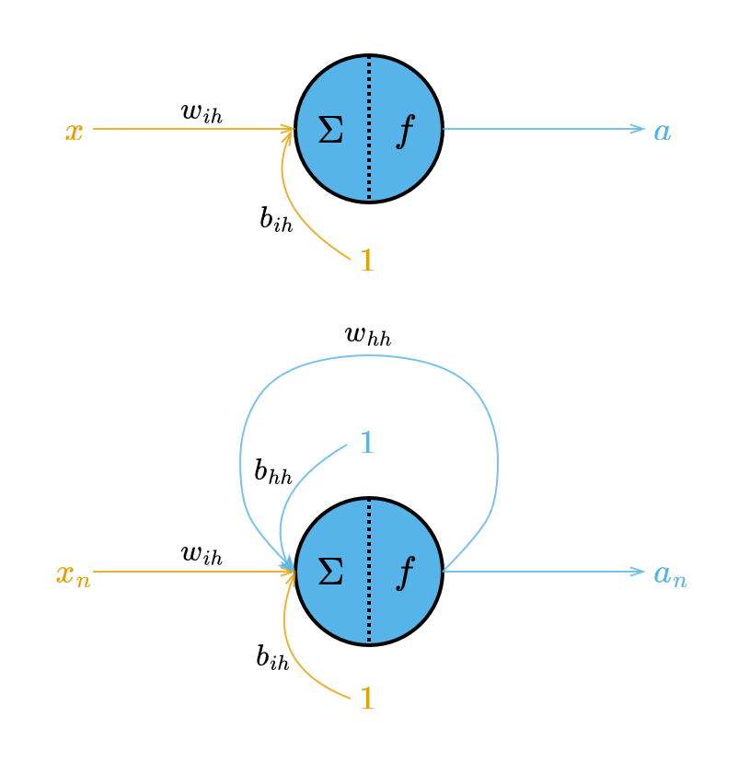
Recurrent neural networks for sequences
Recurrent networks maintain an internal state that allow them to process sequences of variable length and store information about previous inputs.
RNNs are particularly useful for tasks for speech recognition, machine translation and sentiment analysis, where context and sequential dependencies are important.

Slide 8
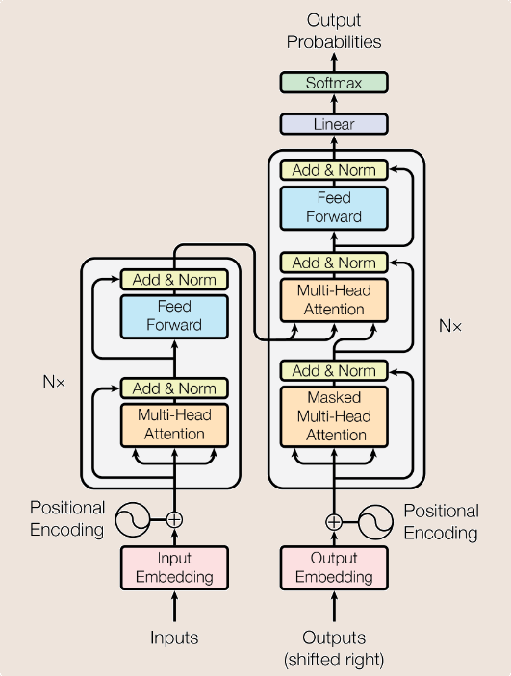
Transformers
Transformers have replaced RNNs as the primary neural network architecture for NLP tasks since introduced in 2017¹.
¹Ashish Vaswani, Noam Shazeer, Niki Parmar, Jakob Uszkoreit, Llion Jones, Aidan N. Gomez, Łukasz Kaiser, and Illia Polosukhin. 2017. “Attention is all you need”. In Proceedings of the 31st International Conference on Neural Information Processing Systems (NIPS'17)

Slide 9
GPT – Generative Pre-Trained Transformer
Family of LLMs created by OpenAI starting with GPT-1¹ in 2018 all the way up to GPT-4 in 2023 (including ChatGPT).
Decoder-only architecture made up of multiple transformer layers.
The neural network is first pre-trained on a very large corpus of natural language text so that it can generate new content.
Then, it is fine-tuned to perform a particular task.
¹https://cdn.openai.com/research-covers/language-unsupervised/language_understanding_paper.pdf

Slide 10
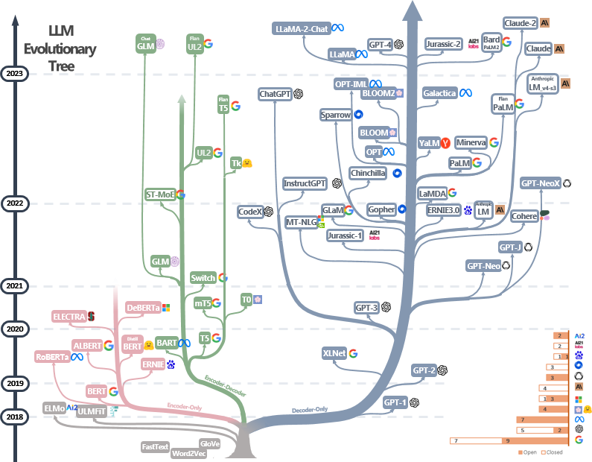
The Transformer Family Tree
Source: https://github.com/Mooler0410/LLMsPracticalGuide/blob/main/imgs/tree.png

Slide 11
What are Large Language Models?
NLP saw a huge shift in mid-2010s towards the use of neural networks to solve a number of tasks.
A language model represents natural language data as a probabilistic model.
A “large” language model uses deep neural networks (mostly transformers) to model the natural language data.

Slide 12
Contents
Introduction to Large Language Models
LLM-based NLP tasks
Hugging Face 🤗

Slide 13
LLM-based NLP Tasks
Summarization
Semantic Similarity
Sentiment Analysis
Machine Translation
Question Answering
Text/Code Generation
Conversation
Zero-Shot/Few-shot classification

Slide 14
Contents
Introduction to Large Language Models
LLM-based NLP tasks
Hugging Face 🤗

Slide 15
Hugging Face 🤗
Provides access to thousands of open-source LLMs and datasets on their hub https://huggingface.co/
Also provides the following Python libraries for easy interfacing with LLMs and datasets:
transformers
datasets
Another popular Python library for working with transformer models is
sentence-transformers https://www.sbert.net/

Slide 16
Hugging Face Pipelines
The transformers library allows us to create and use pipelines (combinations of tokenizers and pre-trained models) for different tasks. https://huggingface.co/docs/transformers/v4.33.3/en/main_classes/pipelines#transformers.pipeline
Hugging Face pipelines provide an easy way to use pretrained models in Python for common NLP tasks like sentiment analysis, summarization, question answering, etc.
Pipelines abstract away the model and tokenization, so we can use them with just a few lines of code.

Slide 17
Contents
Introduction to Large Language Models
LLM-based NLP tasks
Hugging Face 🤗

